Slide 1
Unit-1 Concept and Aims of Teaching of Mathematics
Topic:- A Mathematical Theorem and Its Variants-Converse, Inverse and Contra Positive, Proofs and Types of Proofs
By-Dr. Meena Sharma

Slide 2
CONVERSE

Slide 3
Inverse

Slide 4
Contra POSITIVE

Slide 5
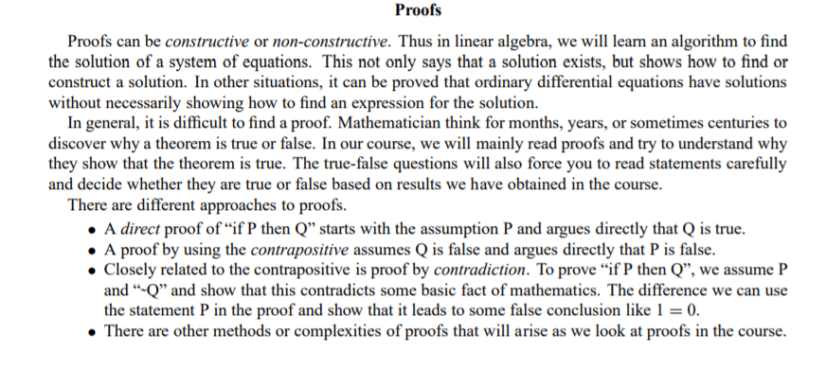
Proofs and Types of Proofs

Slide 6
Fight COVID-19
Stay Home
Stay Healthy
Wash Hands
Use “Aarogya Setu” App
Maintain Social Distancing
Thank You

